Slide 1
CSE299 · SECTION 10 · TEAM NEXUS
Sprint 6 Weekly Project Review
A Full-Stack Code Audit — 35 Issues Found, Diagnosed, and Fixed
SPRINT SNAPSHOT Window: Aug 18 – 24, 2026 | Status: Completed · 100% | Priority: High | Duration: 1 week
Jihanur Rahman Ratul (Jihan)
Tahsin Ahmed Sufol
Audit Execution, Security Fixes & Testing
Review Support & QA
Prepared for ITN Sir · CareerSetu — NSU Alumni-Industry Bridge Platform

Slide 2
PROJECT OVERVIEW
CareerSetu, at a Glance
Six sprints in, CareerSetu has gone from a working backend to an audited one: a full sweep across authentication, authorization, database hygiene and frontend wiring turned up 35 discrepancies — and closed every one of them.
SPRINT-BY-SPRINT STATUS
100%
Sprint 1
Completed
Jul 6 – 13
Data collection: NSU alumni & company datasets
That sweep is what Sprint 6 became: not a new feature push, but a systematic pass through a shared checklist — Auth Foundation, RBAC & Authorization, Frontend Wiring, Frontend Polish & UX, and Feature Fixes — verified with automated tests and a manual frontend pass.
100%
Sprint 2
Completed
Jul 13 – 21
Repository, branching strategy & CI/CD pipeline
This report covers Sprint 6 (Aug 18 – 24) — the audit tracker, the 35 fixes it drove, and what's next: choosing a deployment platform and taking CareerSetu live in Sprint 7.
100%
Sprint 3
Completed
Jul 21 – Aug 3
10-page Next.js frontend, fully designed & built
100%
Sprint 4
Completed
Aug 4 – 10
Backend API, ML microservice & CI/CD integration
100%
Sprint 5
Completed
Aug 11 – 17
Relational database layer, live API wiring & CI/CD fix
100%
Sprint 6
Completed
Aug 18 – 24
Full-stack security audit — 35 issues found & fixed
CareerSetu | Sprint 6 Weekly Review | CSE299 Sec.10
02 / 14

Slide 3
SPRINT 6 · AUG 18 – 24, 2026
Sprint Goal & Key Deliverables
SPRINT OBJECTIVE
Run a full-stack code audit across CareerSetu — authentication, RBAC, database hygiene, frontend wiring and UX — logging every discrepancy in a shared tracker and closing all of them out with tested fixes before moving to deployment.
SPRINT META
Completed · 100%
High Priority
QA
Backend
Frontend
DevOps
KEY DELIVERABLES
Duration
AUDIT_FIX_TRACKER.md — a 35-item checklist across 5 phases (Auth Foundation, RBAC & Authorization, Frontend Wiring, Frontend Polish & UX, Feature Fixes), every item checked off
1 week — audit ran the full Aug 18–24 window
Owner
New app/auth_utils.py — real bcrypt hashing, JWT helpers, get_current_user and require_role — closing every flagged auth gap
Jihanur Rahman Ratul (lead) — audit execution, all 35 fixes & testing, reviewed with Tahsin Ahmed Sufol
Role guards, an IDOR fix on /auth/me, query-escaping and input validation added across the admin, jobs and alumni routers
Files Shipped
4 new files (auth_utils.py, .env.example, AUDIT_FIX_TRACKER.md, sprint-6.md) & 14+ updated backend/frontend files
Automated pytest suite (tests/test_api.py) plus a manual frontend pass — zero TypeScript errors, route guards verified on /admin and /employer
CareerSetu | Sprint 6 Weekly Review | CSE299 Sec.10
03 / 14

Slide 4
WEEKLY PROGRESS
How the Sprint Unfolded
✓
Aug 20
The Sprint 5 CI/CD fix — health endpoint + retry loop — is committed, closing the pipeline issue right as the Sprint 6 audit begins.
HOW WE TRACK PROGRESS
•
Aug 22
Slack (#299) stays quiet this sprint — most of the work lands directly in commits and the shared audit checklist, not chat. AUDIT_FIX_TRACKER.md, sprint-6.md and the Notion Sprint Tracker remain the source of truth for what shipped — this week, a fully closed 35-item list.
Tahsin (ahmed.md) replies in Slack — “I didn't find it..” — after searching for the flagged issue.
▤
Aug 24
.env.example and the JWT/DB/CORS config template are committed, closing Phase 1's environment-hardening items.
▤
Aug 24
Antigravity IDE's task tracker shows the AI-assisted audit still mid-run on Phases 3–5: frontend wiring, polish and feature fixes.
!
Today
Jihan posts in Slack: the audit is fixed, asks Tahsin to review Sprint 6 for bugs, and flags Firebase or Vercel as deployment options.
This week's deliverable is the audit itself — a systematic checklist treated with the same documentation rigor as a shipped feature.
✓
Since
All 35 AUD items are checked off in AUDIT_FIX_TRACKER.md; sprint-6.md documents the pytest suite and frontend verification; Notion marks Sprint 6 Completed at 100%.
CareerSetu | Sprint 6 Weekly Review | CSE299 Sec.10
04 / 14

Slide 5
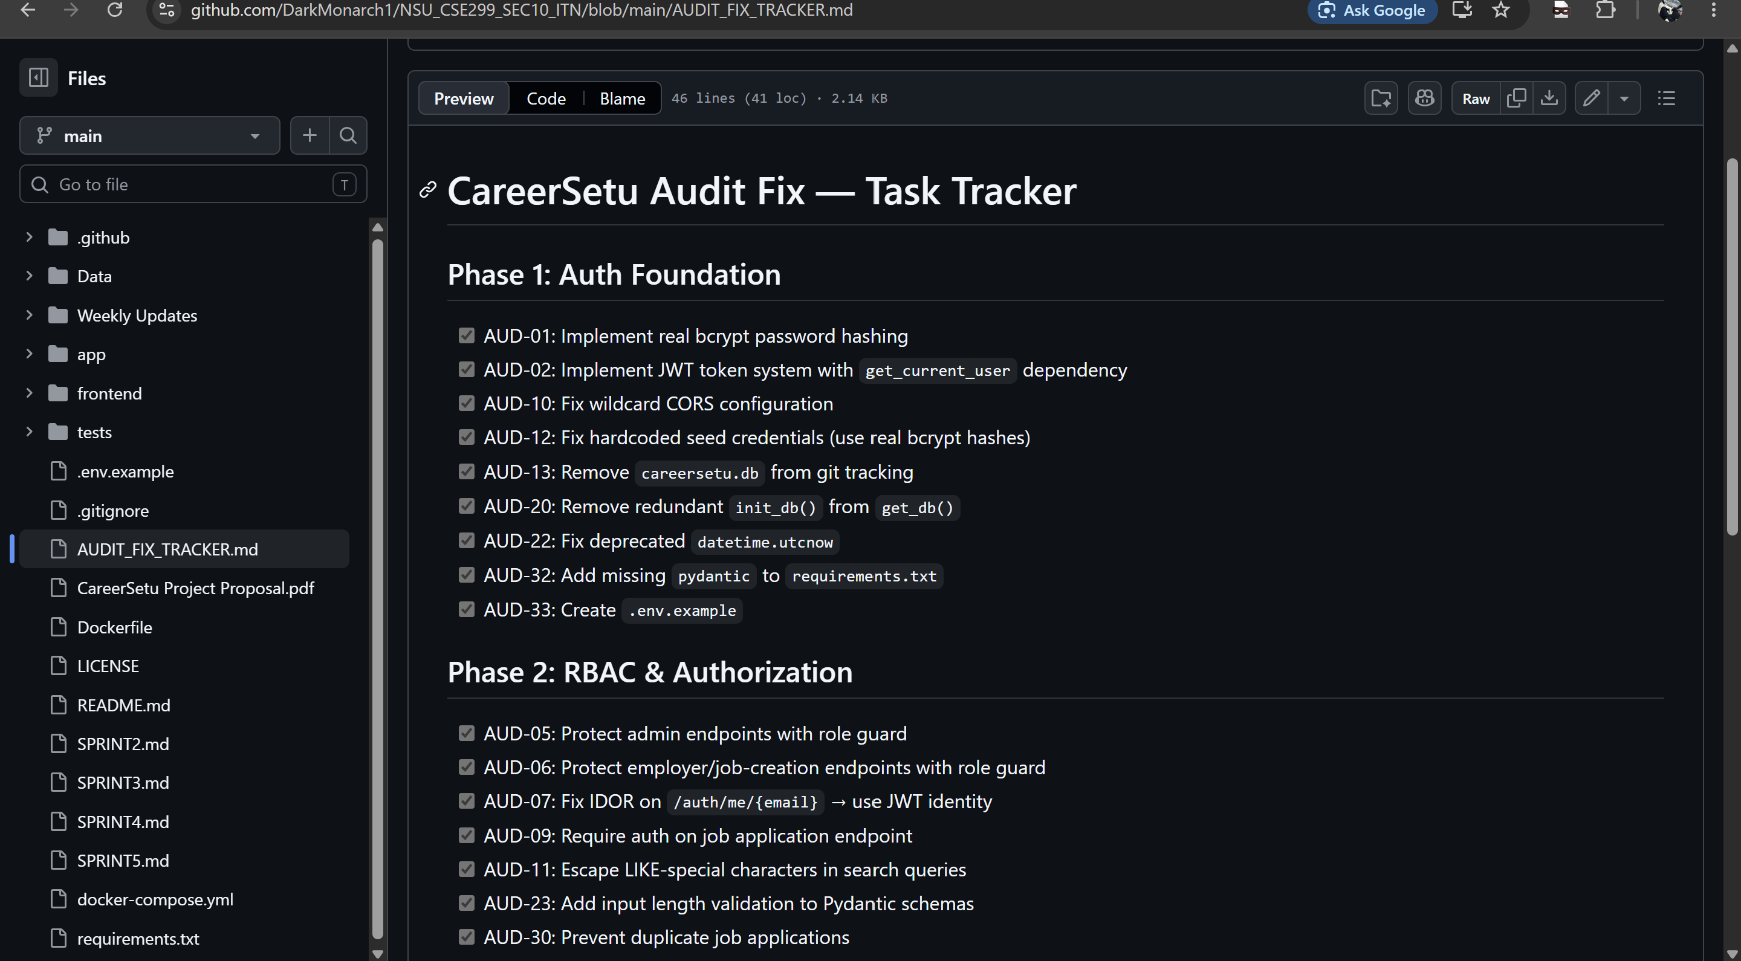
EVIDENCE · 1 OF 5
The Audit Tracker — Auth Foundation & RBAC
github.com/DarkMonarch1/NSU_CSE299_SEC10_ITN — AUDIT_FIX_TRACKER.md
Phase 1 (Auth Foundation) closes 9 items: real bcrypt hashing, a working JWT system, wildcard CORS fixed to explicit origins, hardcoded seed credentials replaced with real hashes, and .env.example added
Phase 2 (RBAC & Authorization) closes 8 items: admin & employer endpoints behind role guards, an IDOR fix on /auth/me using JWT identity instead of an email path param, and duplicate-application prevention
Every item is a checked GitHub checkbox — not a status claim, an auditable, committed record
CareerSetu | Sprint 6 Weekly Review | CSE299 Sec.10
05 / 14

Slide 6
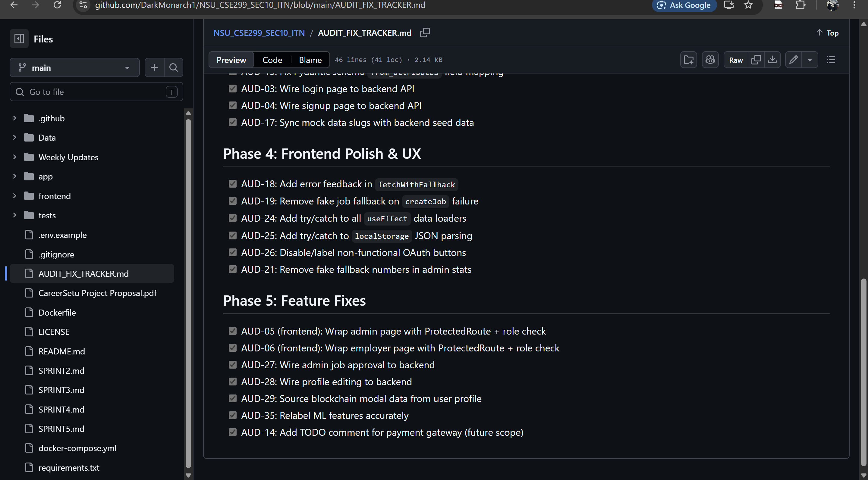
EVIDENCE · 2 OF 5
The Audit Tracker — Frontend Wiring, Polish & Feature Fixes
github.com/DarkMonarch1/NSU_CSE299_SEC10_ITN — AUDIT_FIX_TRACKER.md
Phase 3 (Frontend Wiring) closes 5 items: login & signup pages wired to the backend API, and mock data slugs synced with real backend seed data
Phase 4 (Frontend Polish & UX) closes 6 items: error feedback, try/catch on data loaders & localStorage parsing, and disabled non-functional OAuth buttons
Phase 5 (Feature Fixes) closes 7 items: admin/employer pages wrapped in ProtectedRoute + role checks, and admin job approval & profile editing wired to the backend
CareerSetu | Sprint 6 Weekly Review | CSE299 Sec.10
06 / 14

Slide 7
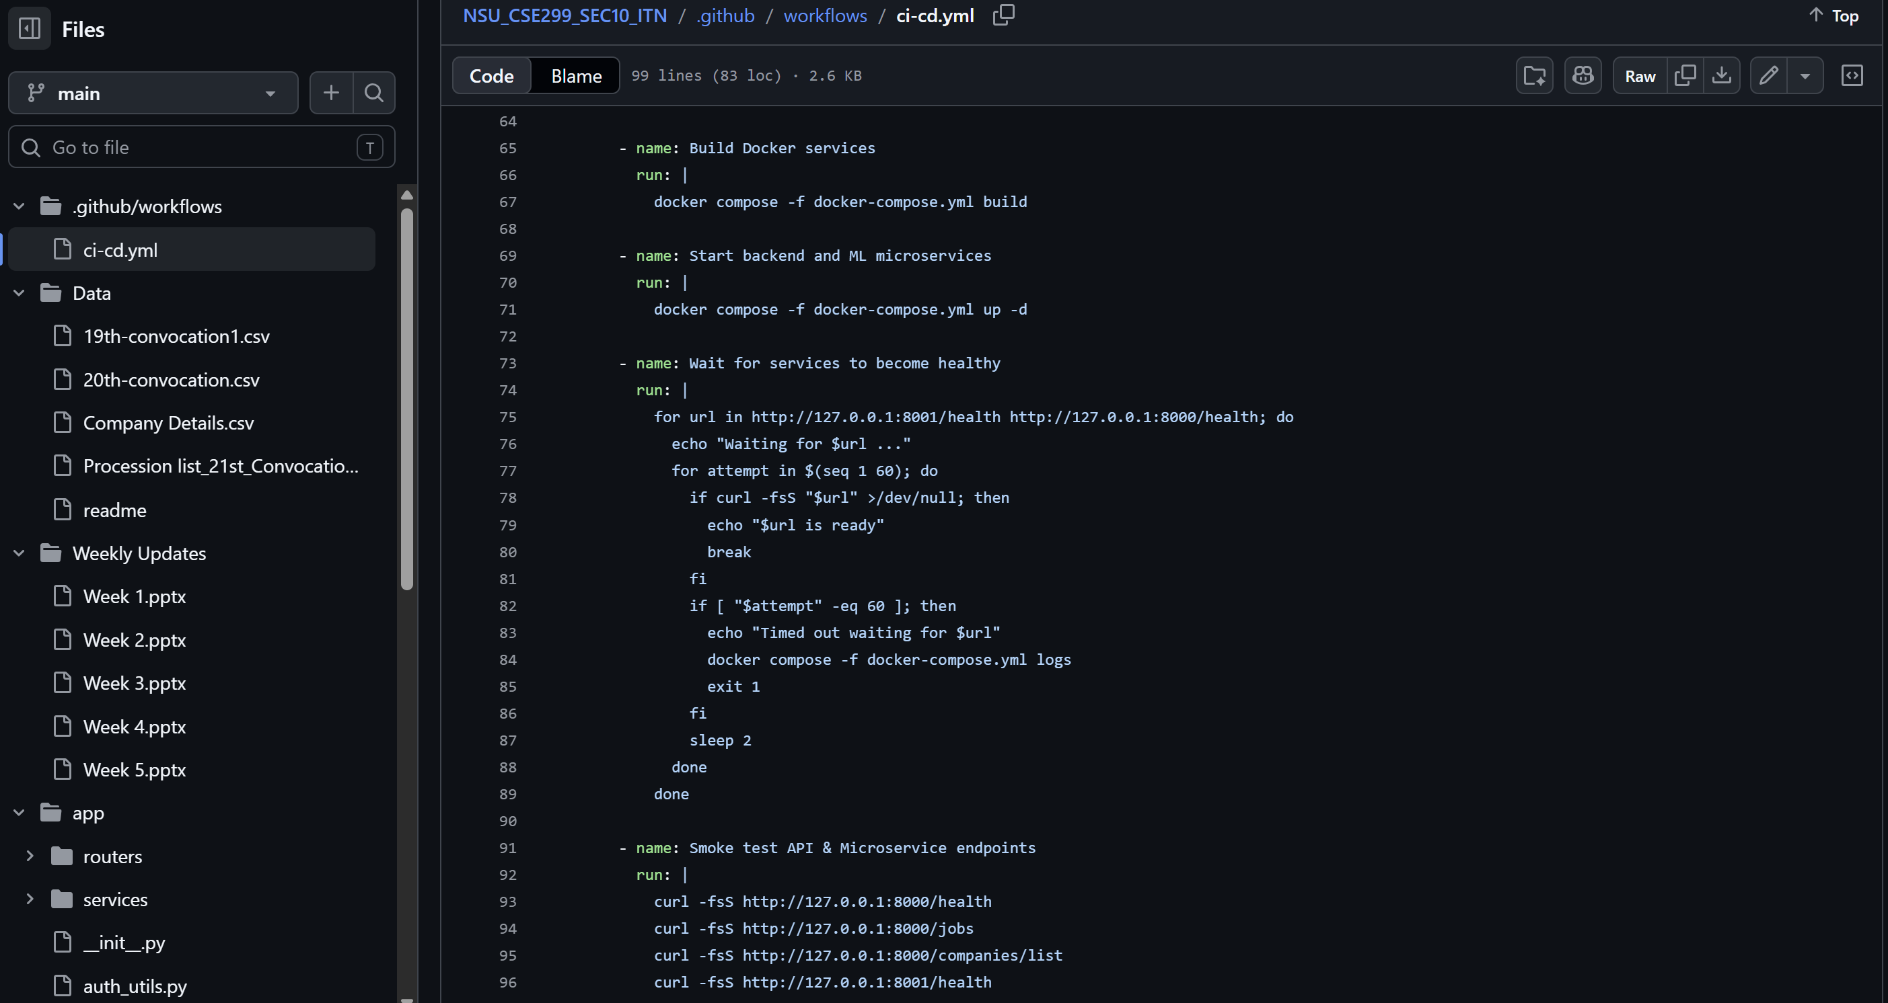
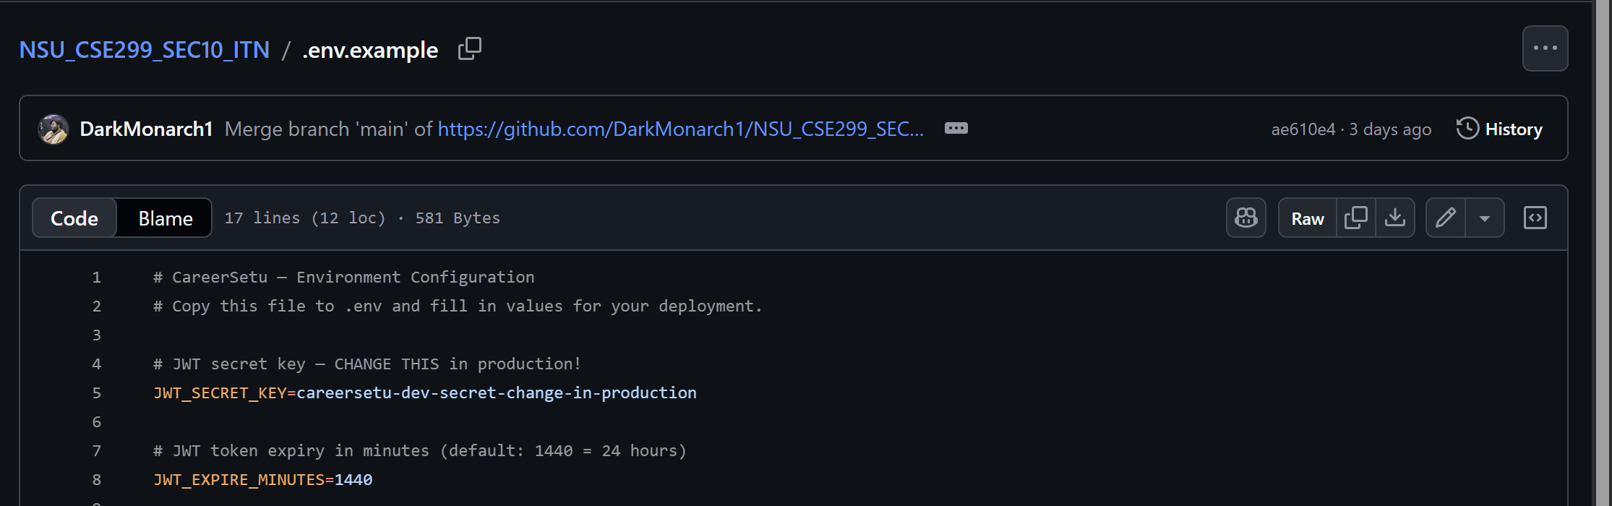
EVIDENCE · 3 OF 5
Environment Hardening & CI/CD Health Checks
NSU_CSE299_SEC10_ITN — .env.example & .github/workflows/ci-cd.yml
.env.example documents the JWT secret/expiry, database URL, ML service URL and CORS origins — the audit's missing environment template (AUD-33)
ci-cd.yml's health-check step still polls both services every 2s for up to 60 attempts before failing — the Sprint 5 fix stays intact through this sprint's audit
Together they close Phase 1's infra items: no more wildcard CORS, no more blind sleep 12, and a documented config surface ahead of deployment
CareerSetu | Sprint 6 Weekly Review | CSE299 Sec.10
07 / 14

Slide 8
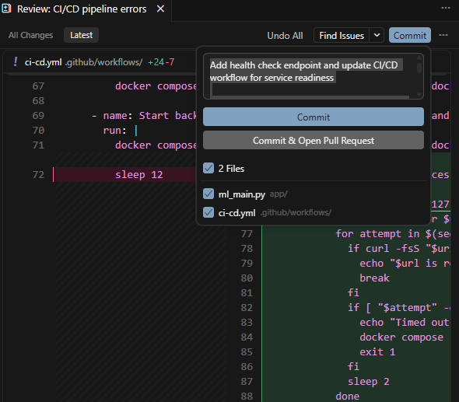
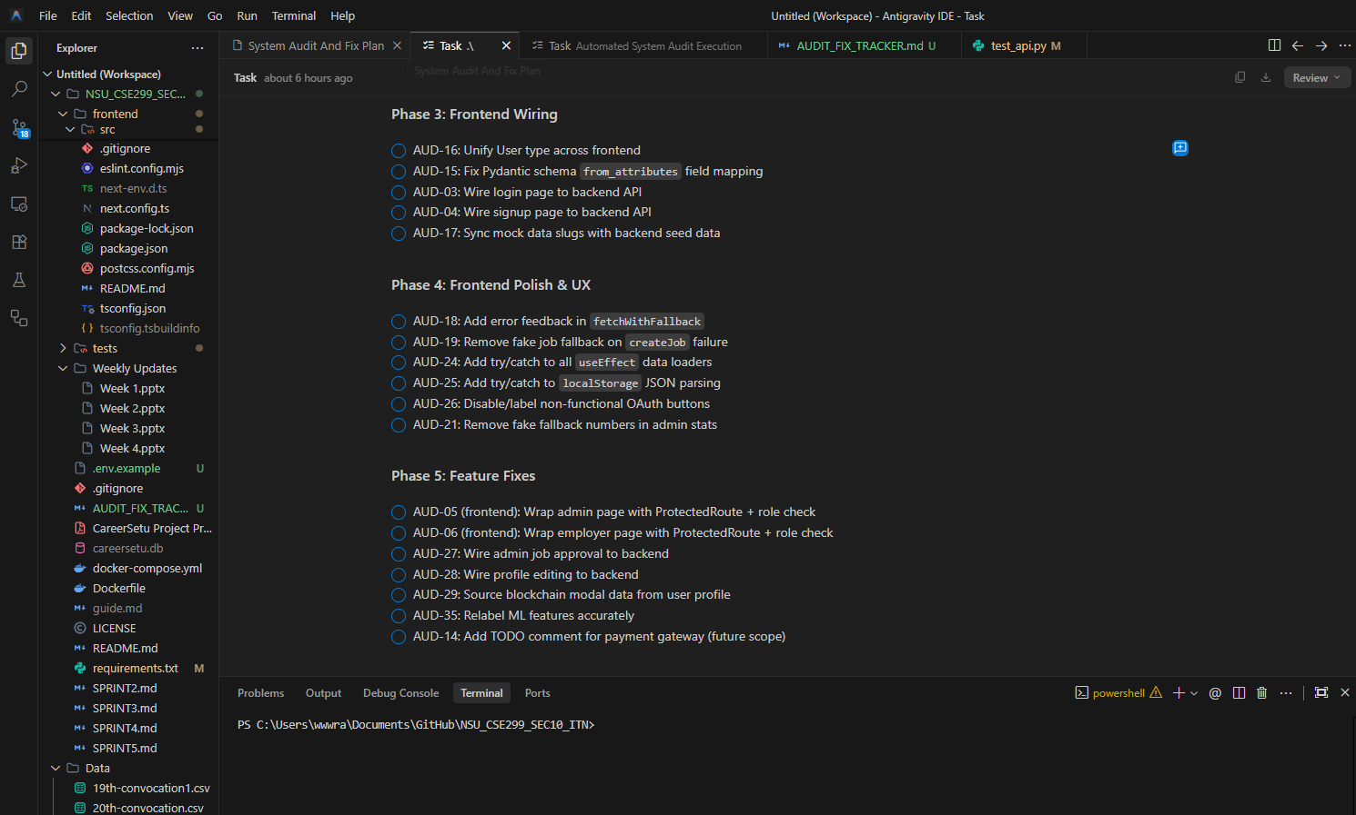
EVIDENCE · 4 OF 5
AI-Assisted Audit Execution
Antigravity IDE — Task Tracker & GitHub — CI/CD Commit Review
Commit review: health-check fix (ml_main.py + ci-cd.yml)
Antigravity IDE — audit task tracker, mid-run (Aug 24)
The team runs the audit through Antigravity IDE's task tracker — each AUD item is ticked off only once its fix is verified, not just written
This checkpoint (Aug 24) catches Phases 3–5 still open — frontend wiring, polish and feature fixes — while Phases 1–2 (auth, RBAC) are already closed
The parallel commit review (ml_main.py + ci-cd.yml) shows the same discipline applied to infra: a named fix, reviewed file-by-file, committed with intent
CareerSetu | Sprint 6 Weekly Review | CSE299 Sec.10
08 / 14

Slide 9
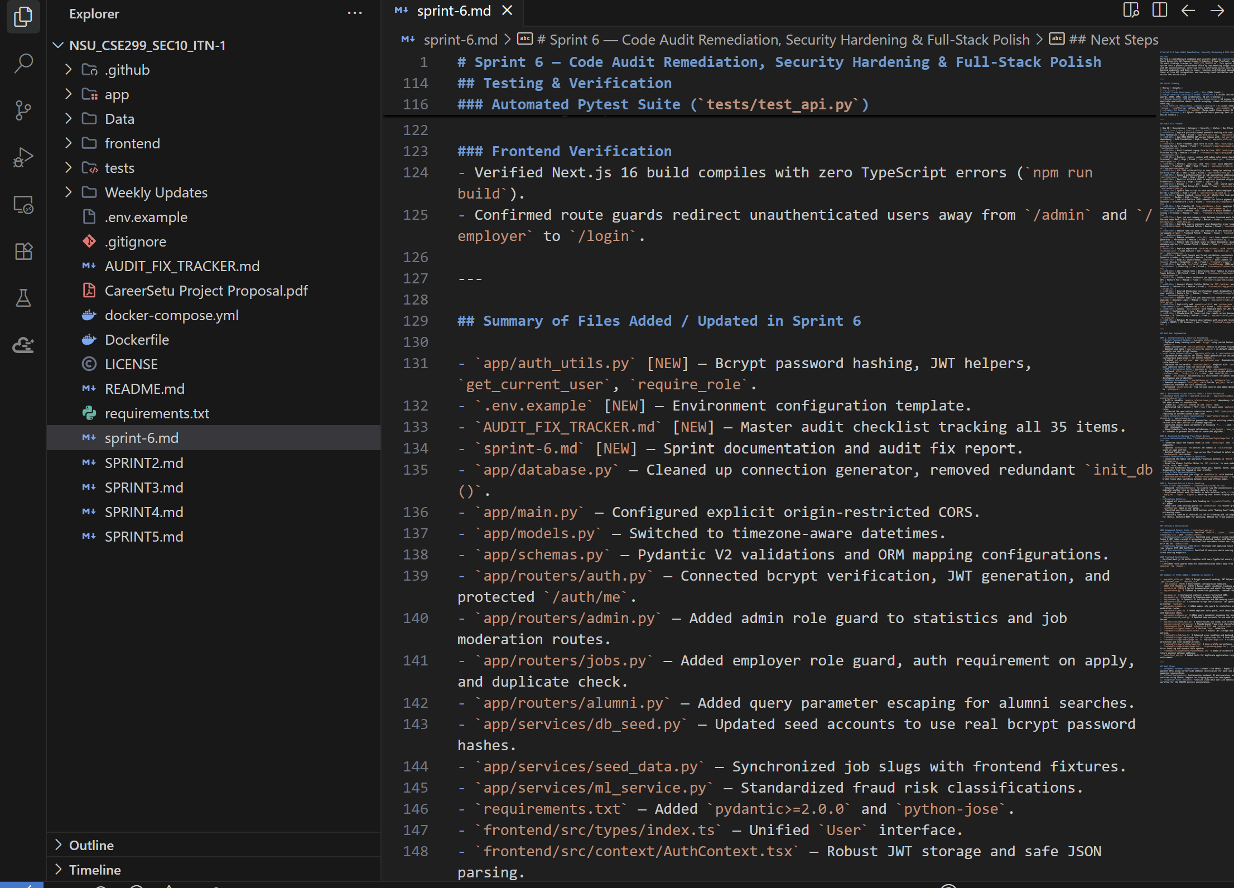
EVIDENCE · 5 OF 5
Sprint Documentation & Verification
sprint-6.md — Testing & Verification, Summary of Files Added / Updated
sprint-6.md documents an automated Pytest suite (tests/test_api.py) alongside a manual frontend pass
Frontend verification confirms a zero-TypeScript-error Next.js 16 build, and that unauthenticated users are redirected from /admin and /employer to /login
A file-by-file changelog lists 4 new files and 14+ updated modules — from auth_utils.py and .env.example to role guards on admin.py, jobs.py and alumni.py
Every fix in the summary maps back to a specific AUD item, keeping the tracker and the codebase in lockstep
CareerSetu | Sprint 6 Weekly Review | CSE299 Sec.10
09 / 14

Slide 10
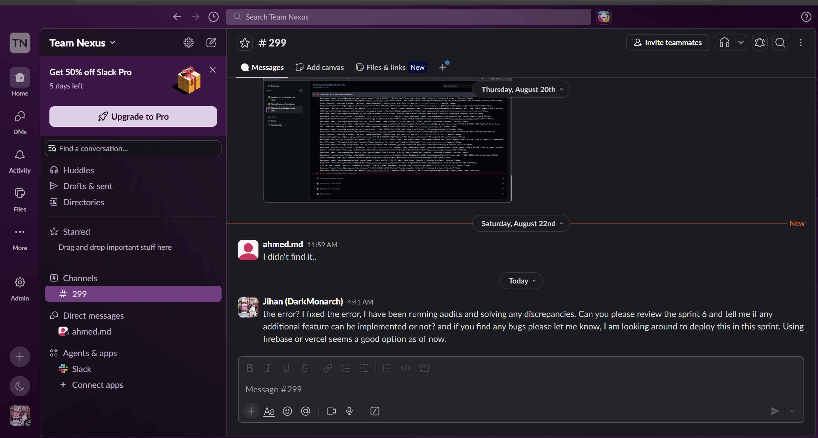
COMMUNICATION REVIEW
Team Communication — Slack
Slack — Team Nexus / #299
The #299 thread stays as light as Sprint 5's — a couple of check-ins, with the real work landing in commits and the audit tracker
Aug 22: Tahsin (ahmed.md) replies “I didn't find it..” after looking for the flagged issue
Today: Jihan confirms the audit is fixed, asks Tahsin to review Sprint 6 and flag bugs, and raises Firebase or Vercel for deployment
No live incident this sprint — the conversation is about closing out review, not debugging a break
CareerSetu | Sprint 6 Weekly Review | CSE299 Sec.10
10 / 14

Slide 11
RISK MANAGEMENT
Risks & Issues
Risk
Likelihood
Impact
Mitigation
Nearly all Sprint 5–6 commits — the CI/CD fix and all 35 audit fixes — are authored by one contributor (DarkMonarch1)
Assign Tahsin owned, committed tickets for Sprint 7 — not review-only involvement
High
High
Tahsin's Slack reply — “I didn't find it..” — suggests thin review coverage on a 35-item audit
Pair-review a sample of the 35 fixes, or add a lightweight PR-review step before merging to main
Medium
Medium
All 35 fixes merged straight to main, with no feature-branch or PR step to catch regressions
Adopt short-lived branches + review for Sprint 7's deployment work, where a bad merge is costlier
Medium
Medium
Deployment target (Firebase vs. Vercel) is still undecided as Sprint 7 begins, and exams have delayed five sprints running
Decide and document the deployment platform early in Sprint 7; keep scope tight given the recurring time pressure
High
Medium
The audit closed cleanly at 100%, but it surfaced a familiar pattern — one contributor doing nearly all the work, now with 35 fixes riding on a single reviewer's judgment.
CareerSetu | Sprint 6 Weekly Review | CSE299 Sec.10
11 / 14

Slide 12
RETROSPECTIVE
What Went Well, What We're Improving
✓
WENT WELL
!
TO IMPROVE
All 35 tracked audit items closed — Phases 1–5 (auth, RBAC, frontend wiring, polish, feature fixes) fully checked off in AUDIT_FIX_TRACKER.md
35 fixes landed on main with no feature-branch or PR review step — a lot of surface area for one reviewer
Real bcrypt hashing, JWT auth and role guards replace every flagged auth/RBAC gap — auth_utils.py ships as one reusable module
Tahsin's Slack reply (“I didn't find it..”) suggests review coverage on the audit stayed thin
An automated pytest suite plus a manual frontend pass back up the fixes, not just the checklist
Deployment platform (Firebase vs. Vercel) is still an open question heading into Sprint 7
The audit itself is documented like a shipped feature — sprint-6.md gives a full file-by-file changelog, not just a completion percentage
100%
Sprint 6 completion (per tracker) — all 35 audit items closed, tested and documented; deployment planning carries into Sprint 7.
CareerSetu | Sprint 6 Weekly Review | CSE299 Sec.10
12 / 14

Slide 13
LOOKING AHEAD · SPRINT 7
Next Sprint: Deployment & Final Polish
SPRINT 7 OBJECTIVE
Pick and configure a deployment platform (Firebase or Vercel), deploy CareerSetu end-to-end, and close out any remaining polish so the platform is demo- and grading-ready.
DELIVERABLE & META
Key Deliverable:
⚠
CareerSetu live on a chosen hosting platform, with environment config, CI/CD and the database layer all verified in production — not just localhost.
Sprint 6 closed 35 issues but leaned on one contributor and skipped PR review. Sprint 7 inherits the deployment decision and the discipline of getting a second set of eyes on higher-stakes infra changes.
Contributors:
Jihanur Rahman Ratul & Tahsin Ahmed Sufol
Priority:
High
Tags:
Deployment / DevOps
CareerSetu | Sprint 6 Weekly Review | CSE299 Sec.10
13 / 14

Slide 14
🙌
Thank You
We welcome your feedback, ITN Sir
SCORING RUBRIC & OPEN QUESTIONS
Does closing a 35-item audit — and documenting it with the same rigor as a shipped feature — reflect the kind of quality process you'd want to see before a final deployment?
CSE299 · North South University · Section 10 · Team Nexus

